Slide 1
Physics-Informed Neural Networks for Geometirc Optics
2023. 09. 11
Jeonghan Lee
Prof. Jeongsu Lee
Smart Factory Major
Gachon University

Slide 2
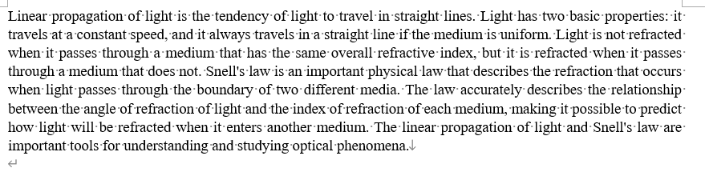
Linear propagation & Snell’s law

Slide 3
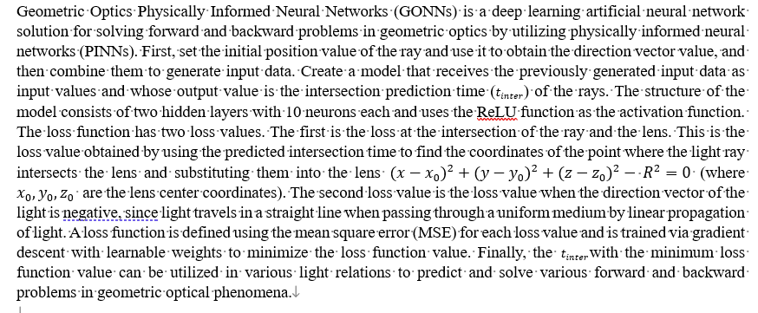
Geometric Optics PINNs (GONN)

Slide 4
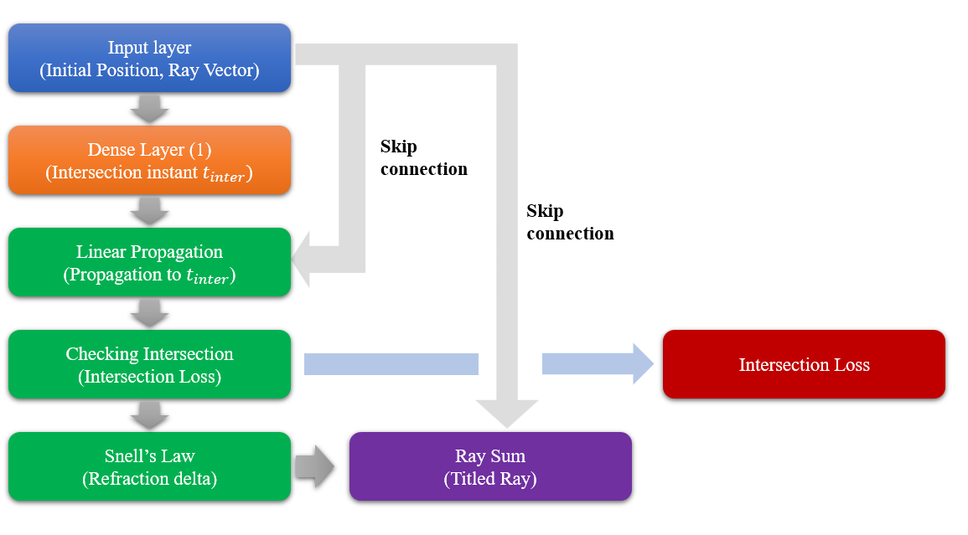
GONN figure

